Slide 1
Class 9

Slide 2
Groups are almost like job titles
User can be assigned to a role, not only a group

Slide 3
Review
Roles, Users, Groups
Roles – used to define access at the application, module, and/or Access Control List.
Grant access to the application/modules that a user has access to in the All menu
Access data in the tables via the ACL (Create, Read, Update, Delete)
Can be assigned to a group or a single user.
Contain other roles.
Users – a user can have more than role.
Groups –

Slide 4
User impersonation
User menu – Impersonate user – select a user – click Impersonate
What ends impersonation:
End impersonation
Log out
Impersonate another user

Slide 5
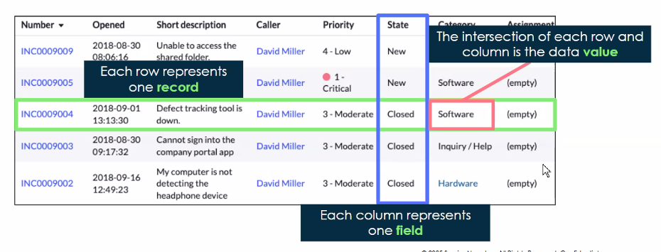
What is a list?
A list displays a set of records from a table within the content frame.
Each row represents a record.
Each column represents a category/field.
Each intersection represents a value.

Slide 6
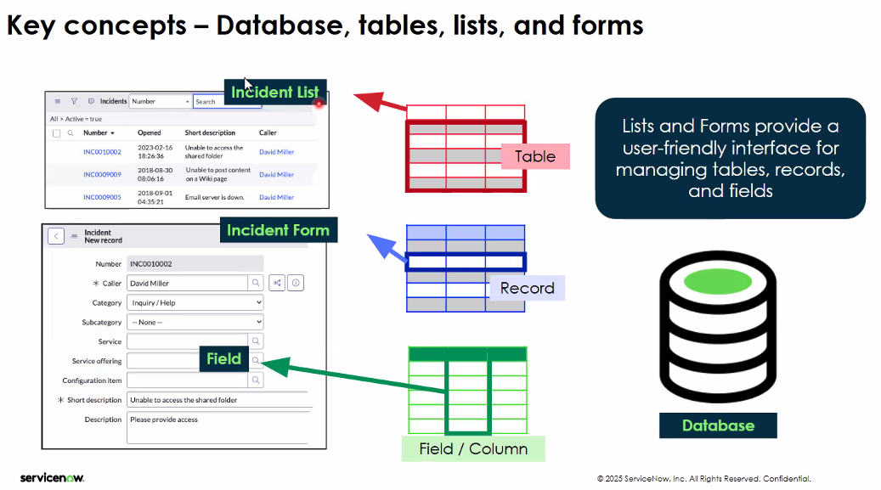
Key concepts – Database, tables, lists, forms
Table is a database.

Slide 7
List Control Menu
Hamburger Menu under All or Favorites – this is options for the entire list. Is a type of context menu that is called a list control menu.
List control menu manipulates the total list we see.
Column list menu manipulated the column.
List – Column – Row

Slide 8
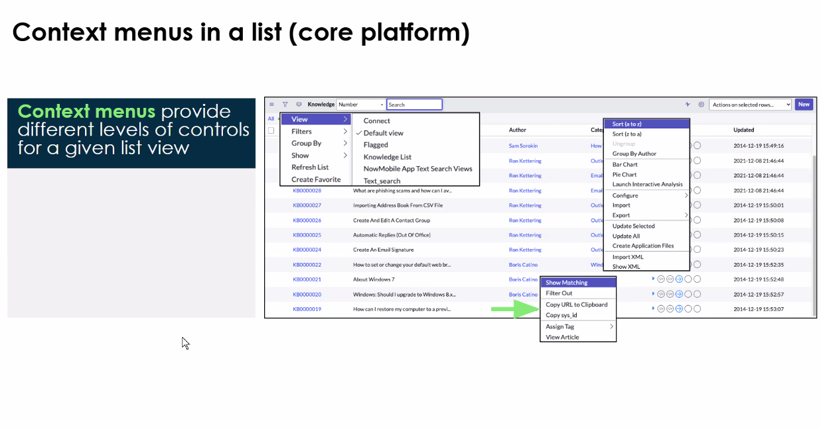
List Filter

Slide 9
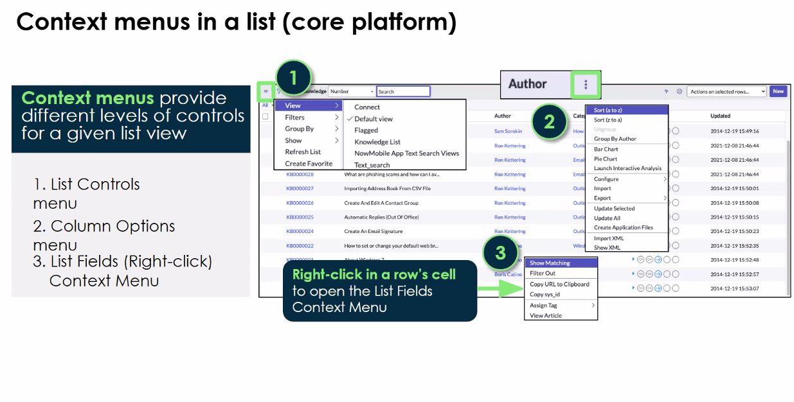

Slide 10
Little plus is another table that we’re accessing and we can borrow info from that table

Slide 11
What does a user see when they open a list?
3 components of a filter condition
Field, condition, value
What is List Collector?
Helps customize the view.

